Slide 1
WELCOME TO MY PRESENTION

Slide 2
BEAUTIFUL Bangladesh
The Most popular Tourist places:
TANGUA HAOR
SHIMULBAGAN
NILADRI LAKE
BAREKKARTILA
BANDARBAN
COXS BAZAR
SAINT MARTIN ISLAND

Slide 3

Tanguar haor
This is beautiful Tanguar haor

Slide 4
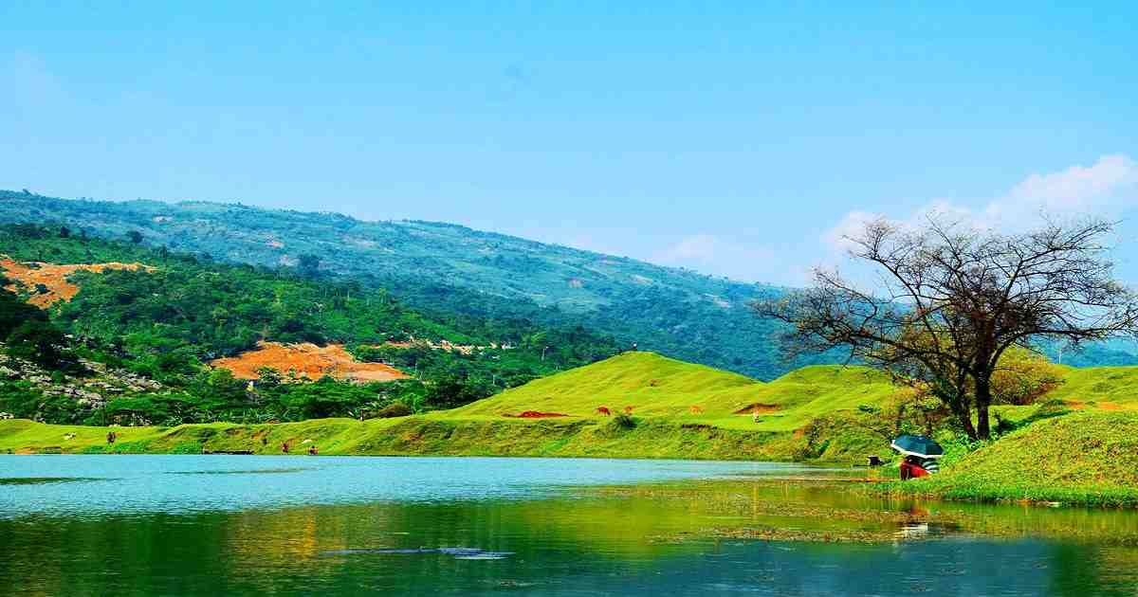
Niladri lake

Slide 5
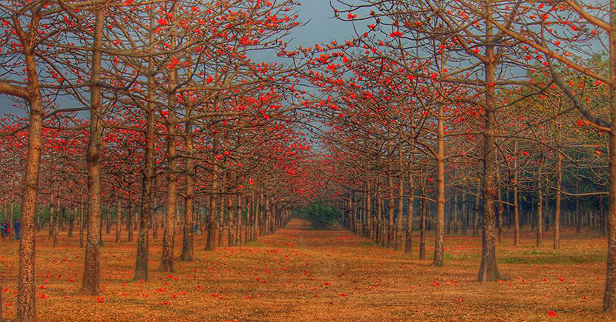
Shimulbagan,badaghat

Slide 6
Day 1: Sylhet to Tahirpur
Morning: Departure from Sylhet
Start your journey early in the morning around 6:00 AM.
Hire a private car or take public transport (bus or CNG) to Sunamganj town (approx. 2 hours).
Mid-Morning: Sunamganj to Tahirpur
From Sunamganj, hire a motorbike, auto-rickshaw, or boat to Tahirpur. The ride takes about 1–1.5 hours.
Enjoy the scenic views of the haor and local villages along the way.
Afternoon: Check-in and Lunch
Check into a local guesthouse or eco-lodge in Tahirpur.
Have lunch with traditional local dishes (fish curry, rice, and seasonal vegetables).
Evening: Explore the Jadukata River
Visit the Jadukata River and Meghalaya hills for breathtaking views of the sunset.
Take a short boat ride on the river and enjoy the serene environment.
Night: Rest
Return to your accommodation, have dinner, and relax.

Slide 7
Travel Options :
By Bus :
Sylhet to Sunamganj : Regular bus services operate between Sylhet and Sunamganj. The journey typically takes about 2 hours. BRTC offers non-AC bus services for approximately 110 BDT and AC services for around 160 BDT. Hive
Sunamganj to Tahirpur: From Sunamganj, you can hire a local vehicle such as a "Leguna" (a type of shared transport) to reach Tahirpur. The fare is around 100 BDT per person.

Slide 8

ENJOY YOUR TRIP
THANK YOU

Slide 9
PRESENTED BY:
MD. RUBEL AHMED
ID : 12
IS-07
(IT SUPPORT FOR OFFICE MANAGEMENT)

